Slide 1

Notes:
Mike will welcome everyone and remind them to put their name and organization in the chat box.

Slide 2
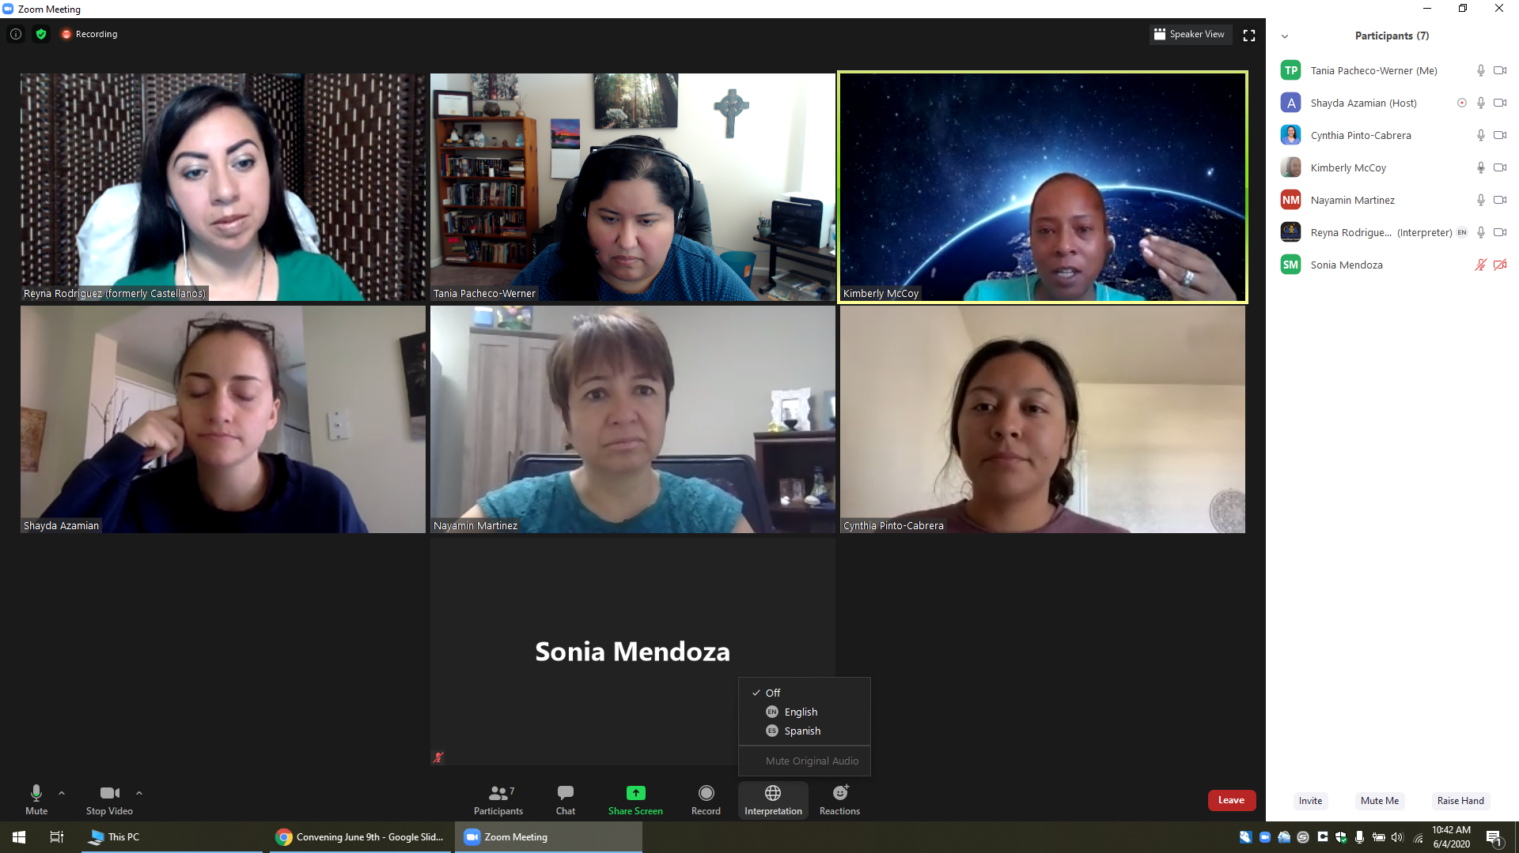
Welcome, Instructions for Zoom
Bienvenidos, Instrucciones para Zoom
Select the World Icon, Then Pick Your Prefered Language
Selecciona el Icono de Mundo, Elije Tu Idioma Preferido
The meeting will have simultaneous interpreting, so you are welcome to comment in your native language.
La junta será interpretada simultáneamente, así que le invitamos a que haga comentarios en su lenguaje nativo.
Tech support:
Para Apoyo Técnico:
Notes:
Nayamin

Slide 3


Slide 4
AGENDA
Vision and Mission
Group Norms/Outcomes
Review of Problems to Policies Training I
Meet the Presenter
Problems to Policies II
Research Meetings
Developing Good Questions
Issues Assembly
Notes:
Mike 2 min

Slide 5
Let’s review our norms...
1. Be open to new ideas
2. Listen to each speaker
3. Make equal time for all to share
4. In person meeting: Please keep your phone on silent, and if you
need to answer the phone, please excuse yourself from the room.
5. During a virtual meeting we encourage you to have the camera on
to be fully engaged, keep your audio on mute
6. Treat others the way you would like to be treated
7. Use the hand icon if you have a question or comment, or put it in
the chat.
Notes:
Wendy 2 min

Slide 6

OUTCOME FOR THIS TRAINING training
Today we will learn what a research meeting is in the process of policy change.
Notes:
Mike 2 min

Slide 7
Vocabulary
System - a set of things working together as parts of an interconnecting network
Policy - a rule for how a system works
Power - the ability to act
Bill- A change to the law that is going through the evaluation and approval process
Notes:
Wendy reviews vocabulary 3 min

Slide 8

Why, How, What?
“Why” will always drive this work with the vision in mind created with our values.
“How” will include our mission statement and goals to achieve in this process.
“What” is the product we will create in the end together.
These are the Big Ideas!
Notes:
Mike explains the Golden Circle 5 min

Slide 9

SYSTEMS ICEBERG
Notes:
Daniel revisits the systems iceberg structure and makes connections to the problems to policies.
3-5 min

Slide 10

Notes:
Tie in to the training about building relationships in community organizing.

Slide 11
PolProblems to Policies II IIP
Christine Barker, FIRM

Slide 12
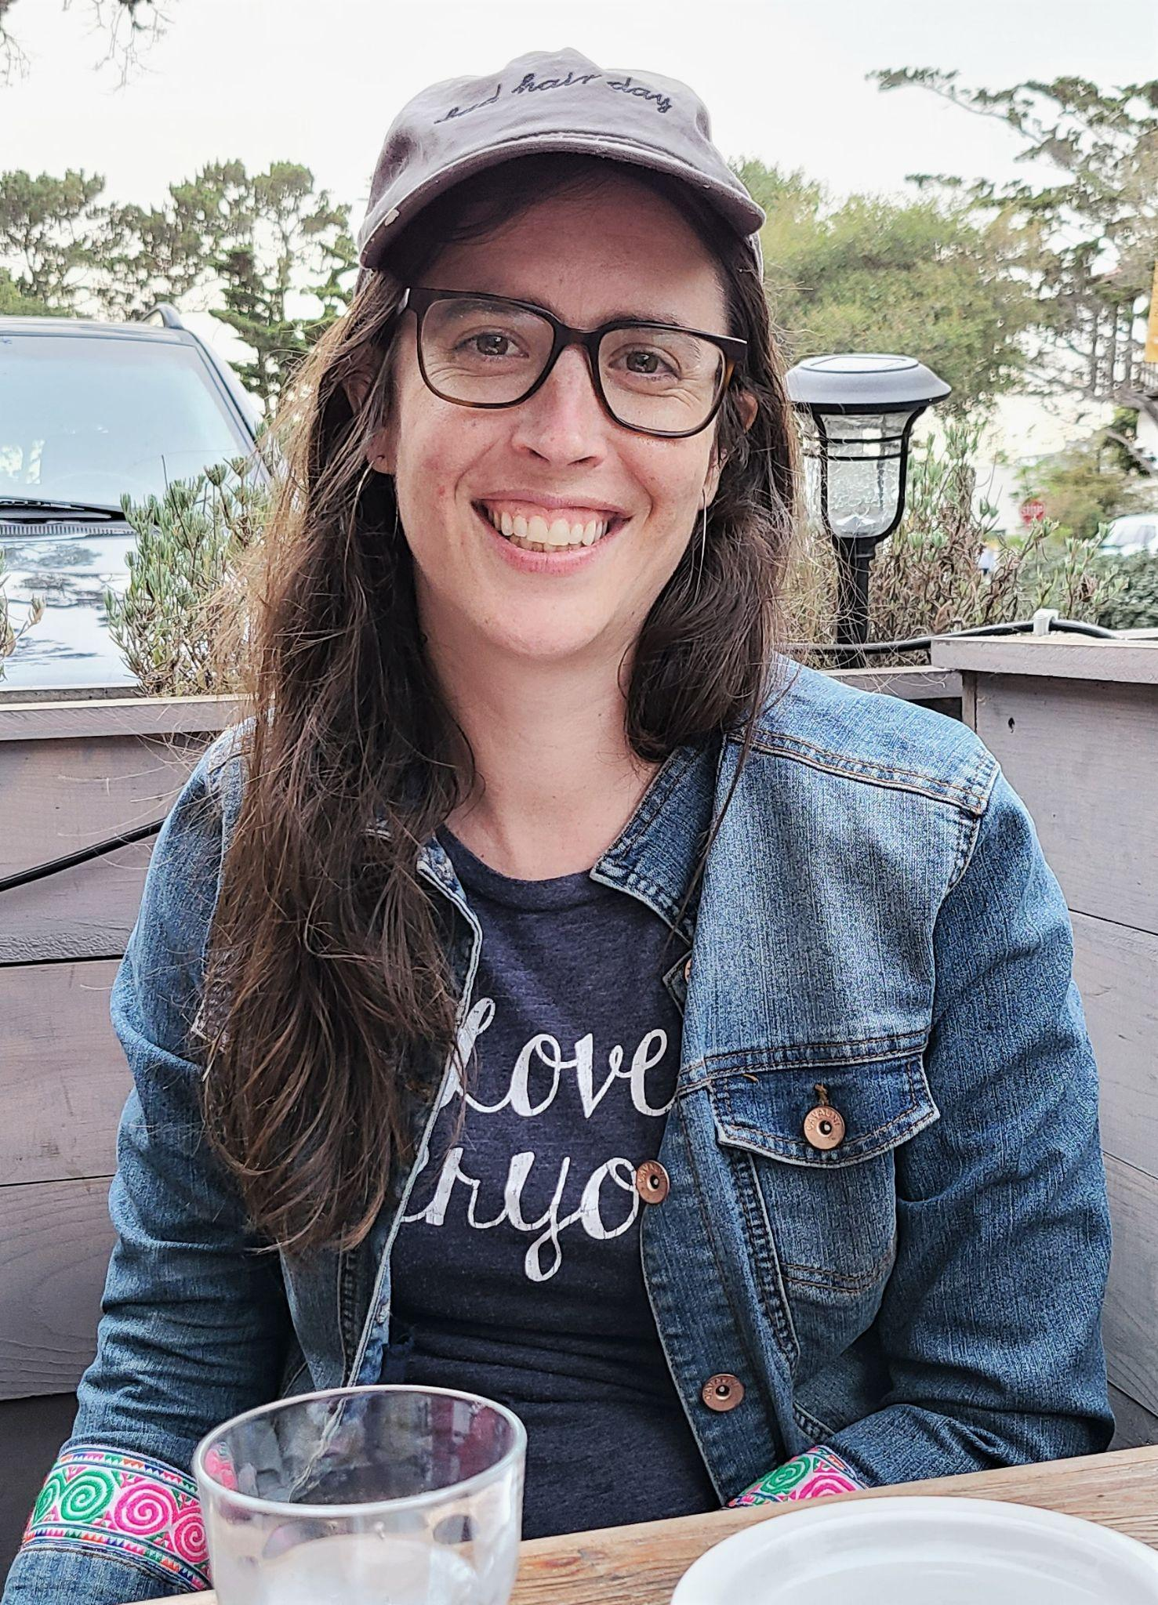
AMMbout MMeMeet your Presenter
Roosevelt High School graduate. My first protests were against FUSD cutting arts funding and the Day without An Immigrant.
Lived in Mexico City, Toronto, New York State. How do places create systems of belonging?
FIRM grew me! General Plan Organizing, BRT, Stopping the Privatization of Fresno’s Trash. Now I’m Executive Director. Most recent policy change efforts are around: Stopping Anti-Asian Hate, COVID-19 Equity, Community Garden Funding.
I was trained in the former PICO model of organizing. I also went to grad school in public administration where I studied systems thinking around immigration and community development.

Slide 13
LeLearning Goals
arning Goals
Learn what a research meeting is
Practice requesting a research meeting
Identify good questions to ask at a research meeting
Tools to Use in Caucus Groups:
Pre-Research Meeting Checklist
Sample Agenda for Research Meeting
Debrief Questions
Notes:
Need to make these tools and distribute.

Slide 14
After naming the problem, talking to others who also deal with the problem, what do we do next?After naming the problem, talking to others who also deal with the problem, what do we do next?
How do we figure out what rules that system is following that lead to our current situation?
How do we figure out how those rules could change to lead to better results?
What is the policy that is leading to this problem?
How do we figure out who is in charge of the system that is causing the problem?

Slide 15

Simple Rules -> Complexity

Slide 16
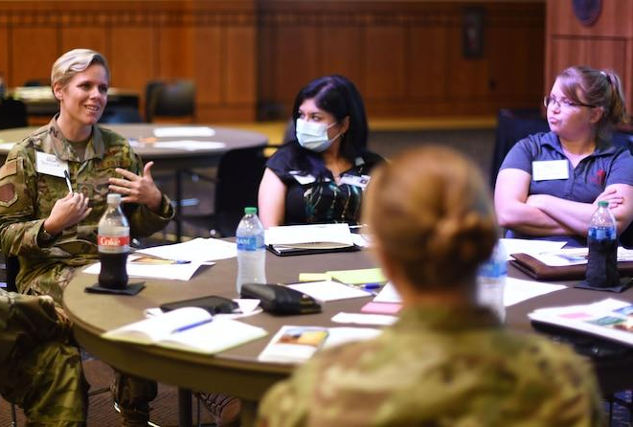
ToTool: Research Meeting
ol: Research Meeting
An intentional conversation with someone inside the system you are trying to
understand and change
A way to learn through asking questions
A way to build your leadership and teamwork skills
A way to build public relationships (ie power)
A way to strengthen your ask

Slide 17



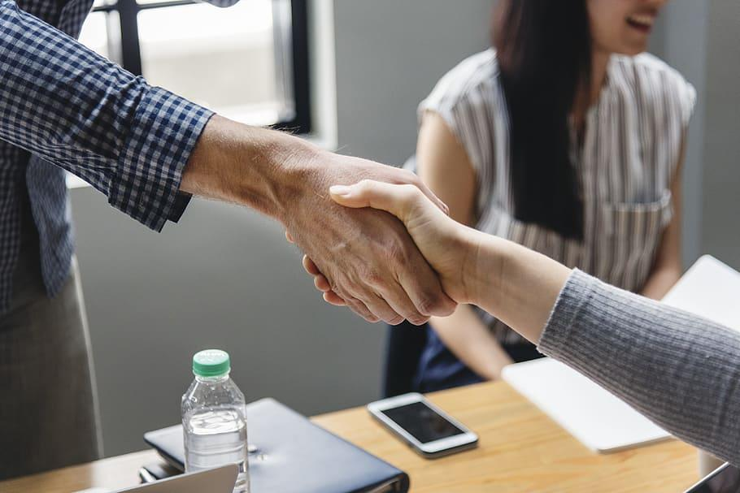
What a research meeting is NOT:hat a research meeting is NOT:
A casual conversation
A 1:1 conversation between you and a public person that you report back to your group
A private or secret conversation
A favor
Asking someone to make an exception for you/your circumstance
An opportunity to make deals or negotiate
A time for demands

Slide 18
Important Ingredients to a Research Meeting
PREPARATION
MEETING
SHARING THE LEARNING

Slide 19
PREPARATION
PREPARATION
Identify the system
Identify WHO might know more about that system
Write questions as a caucus to figure out what you want to know
Reach out to request a meeting. Find a time, date and location that works for as many people as possible
Assign roles to everyone who will be at the meeting
Chair
Timekeeper
Interpreter if needed
Someone to share a testimony: Why this problem matters
Share questions among everyone else
Practice!

Slide 20
PREPARATION: Time to Practice: WHO
In the chat, write the name of one person or position who you think might know more about the policy that is creating the problem that you want to fix.
Who is the person who told you “no, that’s not how it works”?
If you don’t know your name, its okay, write what their job is. Maybe they are the secretary, or the social worker, the teacher, the principal.
Put it in the chat.

Slide 21
PRPREPARATION: Practice Brainstorming Questions
EPARATION: Practice Brainstorming Questions
In the chat, write a WHY or HOW question you have for the principal at your child’s school.
In the chat, write a WHY or HOW question you have for PG&E.
In the chat, write a WHY or HOW question you have for your manager if you rent or your bank if you are paying a mortgage.
Notes:
Por que? Para que? Como?

Slide 22
PREP: Time to Practice: Why do you want to meet?
Think about the person you put in the chat earlier.
Write a note to yourself: why do you want to meet with them?
Take a few seconds to think right now about how you would ask them for a meeting.
Ok, we’re going to go into breakout rooms and you’re going to have 7 minutes. Each person must take turns being the asker, and being the responder.

Slide 23
Debrief Breakout Rooms

Slide 24
PREP: Agenda for a Research Meeting
Date: Time: Location:
Topic:
People Attending:
Introductions
Purpose of Meeting: To Understand Current System/Policy
Testimony about why this problem matters
(develop relationship) How did you get to where you are today?
Why? How? Has it always been this way?
Who else should we talk to about this topic?
Thank you

Slide 25

What makes a good research question?
A question about the SYSTEM
Defining its purpose or intended goal - it’s WHY
About the parts of the system - WHATs
About the relationships between the parts of the system - the system’s HOW
About the perspectives and people that make up the system - WHO
Not Yes or No Questions

Slide 26
THE MEETING
Remind everyone the day before of location, time, date
Arrange rides if need be so everyone arrives early
Coordinate childcare and other responsibilities
Be early
Stay on agenda
Debrief afterwards
What happened?
What went good?
What was surprising?
What did we learn?
What do we do next?

Slide 27
SHARING THE LEARNING
Share what you learned with the whole caucus
Identify what questions you have now
Identify who else you can talk to to answer your new questions
In your caucus, revisit your problem and use research meetings to keep getting clearer on what POLICY is leading to your problem
In your caucus, discuss what you think might help to make a policy change
Make another appointment for another research meeting!

Slide 28
Politicians + Research Meetings
What do elected officials want?
Who has had a meeting with an elected official before? What did they want? What did you want? How did it go?

Slide 29
HOMEWORK: Work with your CBO group
Think about the issue you feel most strongly about and and discuss with your CBO group.
Be prepared to talk about why it is important
RSVP to the Dec. 11 Issues Assembly

Slide 30
Thank you!
Gracias!
Ua Tsaug!

Slide 31
RSVP!!
DECEMBER 11th 10:00 am-1:00 pm
ISSUES ASSEMBLY
Notes:
Mike

